Slide 1
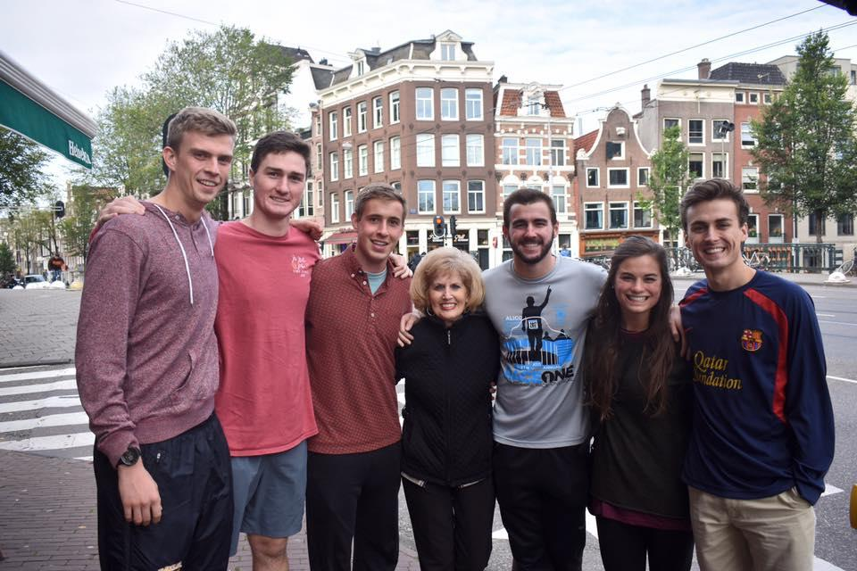
Business Excellence Scholarship Team
What is BEST?
Who are we looking for?
What does BEST do?
Notes:
(30 seconds)
Here are the questions we are going to answer today
What is BEST?
Business Excellence Scholarship Team
Honors-type business course that has been around since 1993
Gives the business school a chance to unite academically excellent students from all business disciplines- over 12 majors this year
Offers a unique classroom setting – open discussion format and Dr. Reed teaches with real-world case studies and hands-on projects like working with local entrepreneurs to create business plans
The following slides will give you answer to ‘Who are we looking for?’ and ‘What does BEST do?’

Slide 2
Requirements & Expectations
Requirements
  Enrolled through May 2019
  Junior by hours
  3.25 GPA
  Prerequisites: MGT 3305, MKT 3305, FIN 3310, MGT 3325
Expectations
  Take two courses for six credit hours
    Fall 2018 – Business Elective
    Spring 2019 - Strategic Management Requirement
Notes:
(30-45 seconds)
Must be enrolled through May of 2018 and committed to taking one class in the fall of 2017 and one in the spring of 2018
Must have juniors hours with a *** GPA
Check on GPA requirement
We are looking for involvement and leadership in and outside of the classroom

Slide 3

Who are we looking for?
  Driven students
        Strong character
        Willing attitude
        Active and involved in class discussions
  Diverse interests
    Involved in extracurriculars
  Demonstrated leadership
Notes:
(30 seconds)
Who are we looking for?
Our current class is made up of a variety of majors with a variety of extracurricular interests & we are looking to replicate that
Students who will bring a great, friendly attitude to the table; contribute to class discussion, be active on committees
Diverse interests and backgrounds- we have multiple presidents within the class currently
We are looking heavily at involvement and leadership in and outside of the classroom

Slide 4
What does BEST entail?
Highlights include:
Team ropes course
Overseas class trip to Prague and Amsterdam
Real case studies
Spring trip to Dallas
Semester-long projects with local entrepreneurs
Companies recruit from within -- EY, Phillips 66
Notes:
(15 seconds)
Here are some of the highlights and how BEST applies to resume and post-grad. They will be explained in further depth in the coming slides.

Slide 5
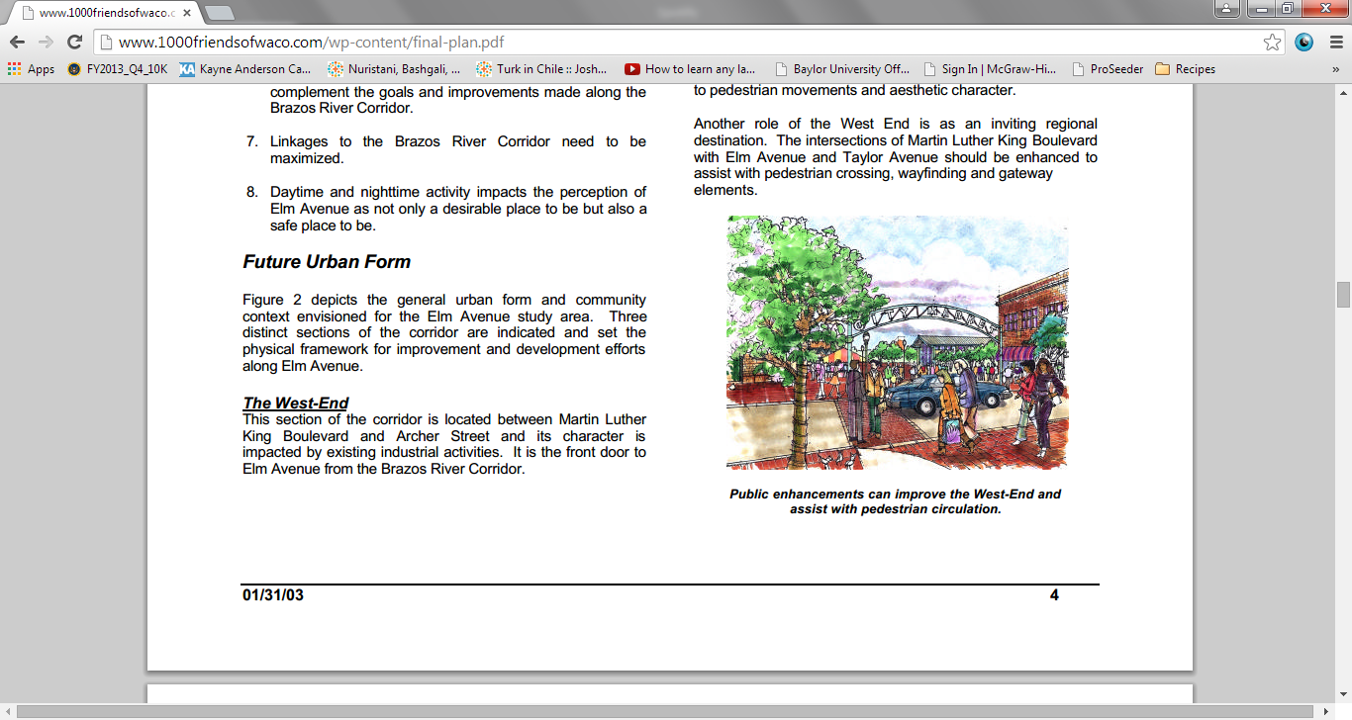
Elm Street Grocery Store
Nancy Grayson from Lula Jane’s
Continuation into 2018-19
Filed as 501(c)(3)
Year-long group project
Marketing, Fixtures, Finance, Operations

Slide 6


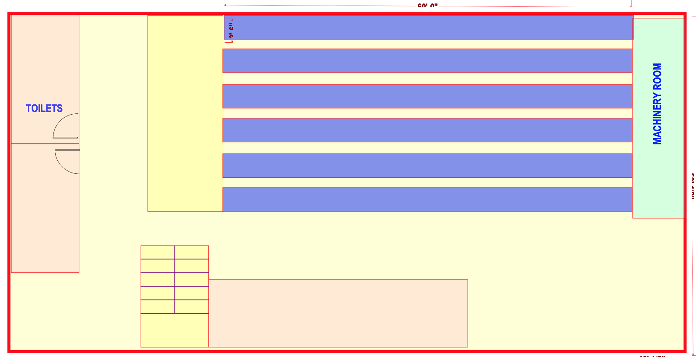
Elm Street Development
Work with Austin Meeks, owner of Pokey O’s
Develop business plans for stores/restaurants on the historic Elm Street
Emphasis on independence and creativity
Business plans were presented on
Downtown Depot

Slide 7
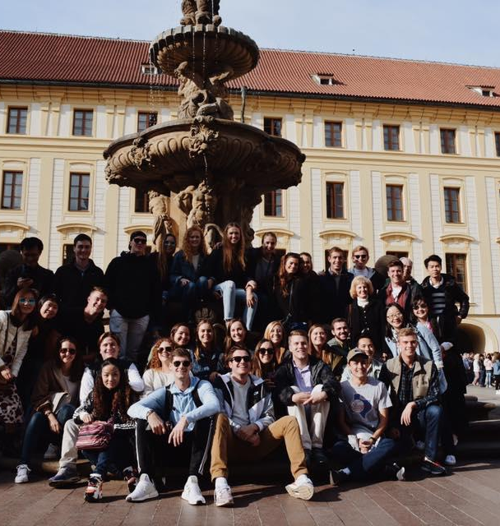
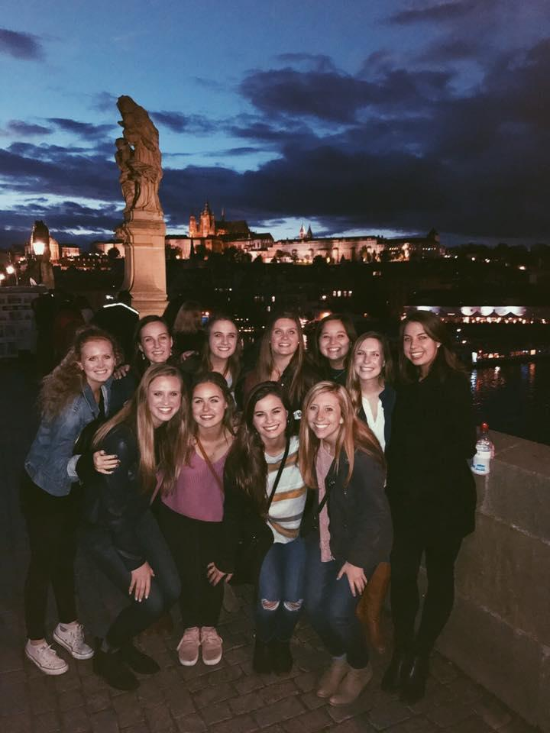
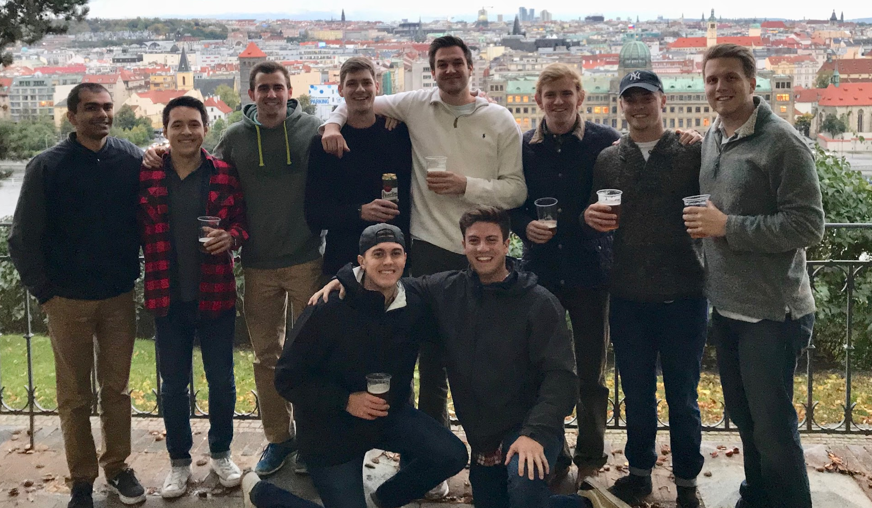

International Class Trip: Prague
Notes:
(30 seconds)
- Here are some pictures from our trip to Prague in
October
- Talk about the case studies that we do in class and when we go to Prague, we get a chance to meet with those business owners and how their businesses have grown and changed.

Slide 8
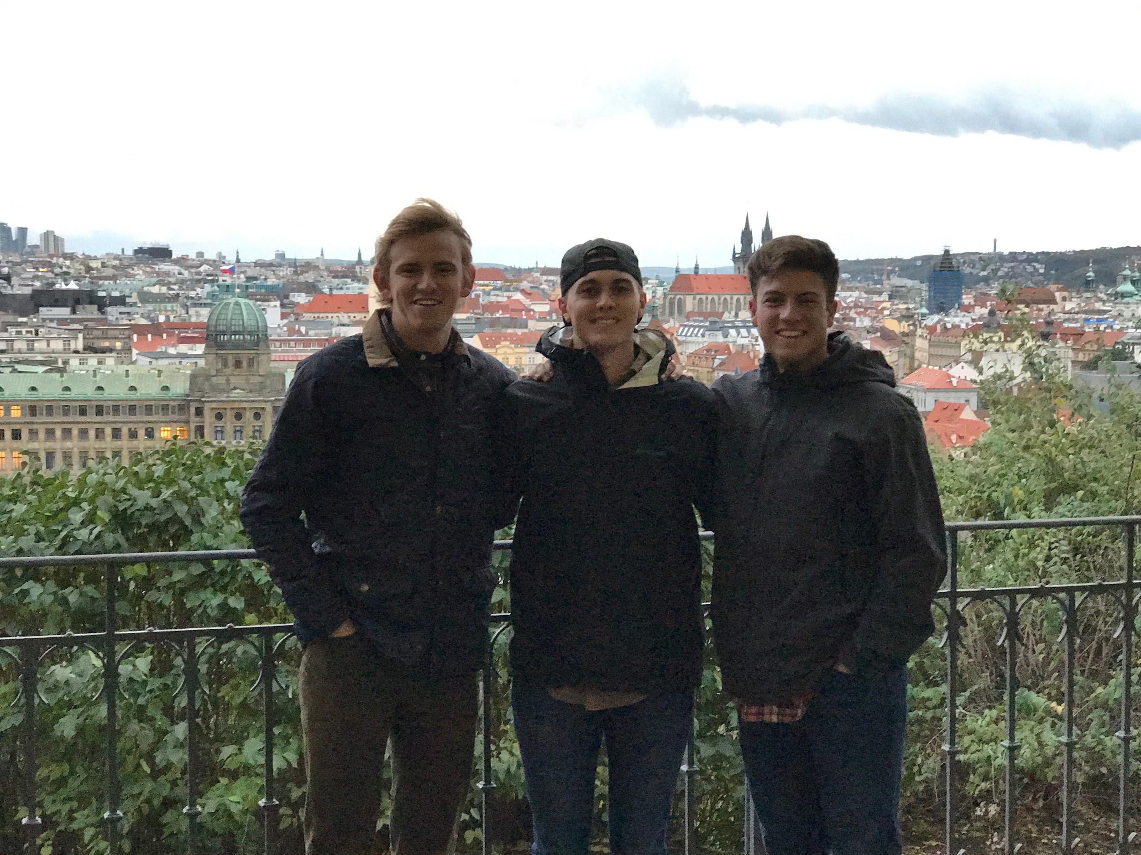
Prague activities
Listen to successful entrepreneurs and directly apply cases from class
Tour Skoda car factory
Visit the Lennon Wall
Spend time in Prague Castle
Explore Terezin, a fortress used as a concentration camp during WWII
Visit the US Embassy
Meet employees from Radio Free Europe
Host a youth group at Youth Praha
Free time to go out to eat, sightsee and explore
Notes:
(1 minute)
highlights of the trip + what we learned by going abroad

Slide 9
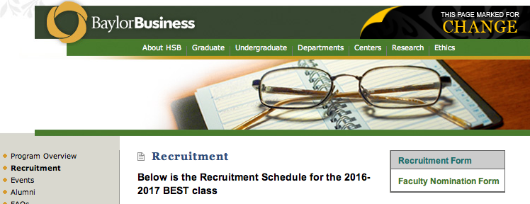
Going Forward
Ask a professor to nominate you
  Nominations due January 31st
  Search ‘Baylor BEST Program’
  Click on the ‘Recruitment’ tab
  Select ‘Faculty
  Nomination Form
Invited to apply
  Applications due February 12th
Interviews February 22-23rd
Class announced March 2nd
Notes:
(1 minute)
Application process:
1) Nominations
Ask a professor to nominate you via an online nomination form
Either tell your teacher how to get to the link or email it them
Nominations due before the end of the day of January 31st
2) After nominations, we will send out invitations to apply
There will be an email will be information about what your application should look like and where to send the application to, plus information about the interview process
3) Interviews will be conducted mid-February
There will be signups posted and again, the email will explain when, where and how to sign up
Dress requirements for the interviews is business professional
4) This timeline will be sent out to all of you tomorrow as well

Slide 10
Current Students
Abby Crawford
Josh Bethany
Hannah Damon
Amye Dickerson
Sam Hart
Alex Moisson
Matt Moore
Bryan Rhodes
Abby Stanger
Parker Davis
Kevin Dooley
Megan Woodrow
Lauren Glick
Zach Morrow
JR Gilley
Katie O’Brien
Kevin Calvert
Will Troop
Jessica Allen
Major Johnson
Mary K Snapp
Eric Ver Duin
William Wright
Daniel Gardner
Jonathan Bellingham

Slide 11
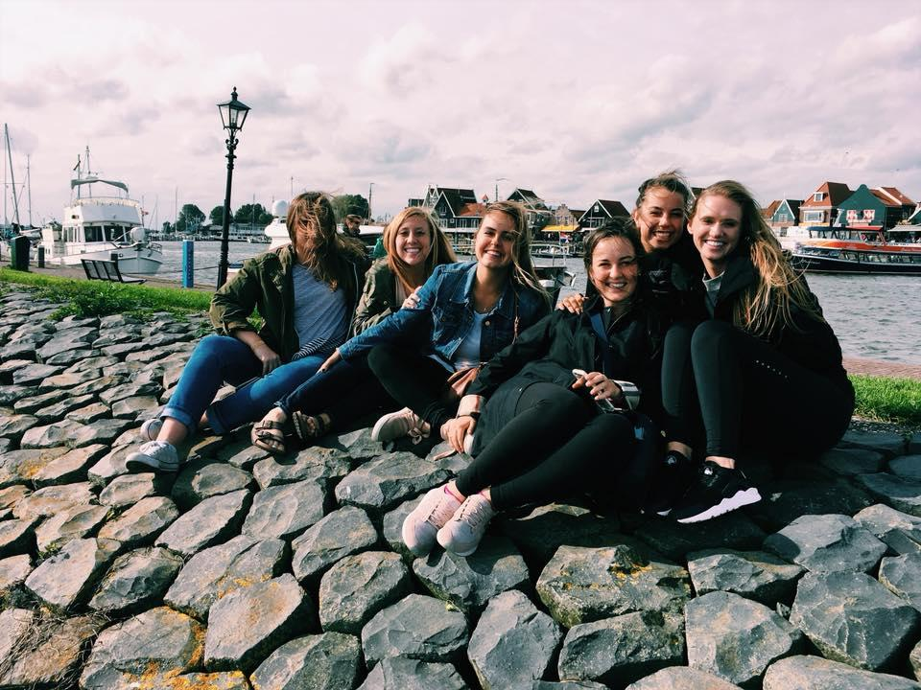
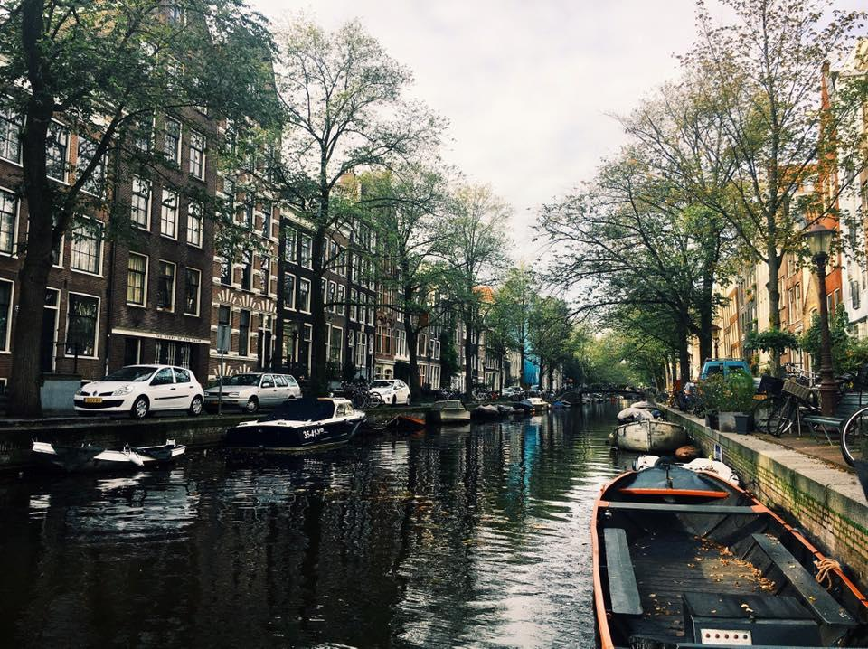
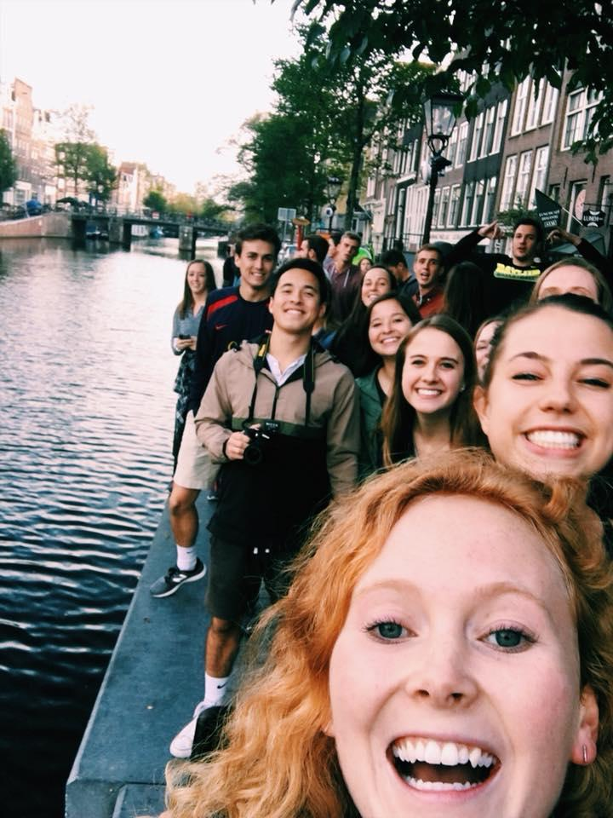
Questions?
William Wright
214-317-6263
W_Wright@baylor.edu
Rachel Hengesh
503-740-0496
Rachel_Hengesh@baylor.edu
Information will be emailed out tomorrow
Notes:
**Whoever does the ‘Going Forward’ slide will also be responsible for opening the floor for questions
Any questions about requirements or what we do in the class or any other specifics?
If not, tell them to stick around and mingle so we can meet them.
+ make sure they have signed in

