Slide 1
Contract Research Organizations
Forrest Williamson
Baylor University
Fall 2012 Colloquium Series

Slide 2
Outline
CROs: What are they and what do they do?
CROs and Pharmaceutical Companies
  Independent Statistical Consulting
  Data Monitoring Committees (DMCs)
Job Opportunities
What did I do? (…no, really!)
FDA

Slide 3
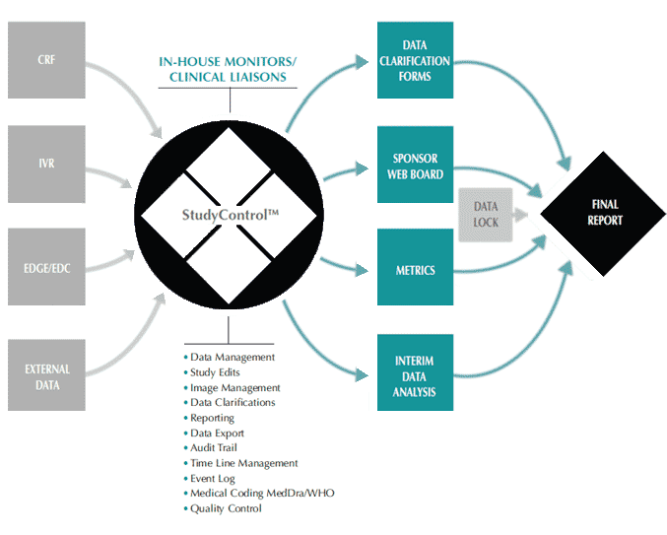
CROs: What are they and what do they do?

Slide 4
CROs
Contract Research Organization
“A person or an organization (commercial, academic, or other) contracted by the sponsor to perform one or more of a sponsor's trial-related duties and functions.“ ICH-GCP (E6 1.20)
Notes:
Def. specifically relating to CROs providing clinical-trial services.
Not all CROs work on clinical trials.
Perform analysis the sponsor is unable to, due to blinding → CROs are essential.
“Clinical research organization”.

Slide 5

CROs and Pharmaceutical Companies

Slide 6

Independent Consulting
$20 billion / year
Smaller pharma companies
  Study Design & Power
  Interim & Final Analyses
Larger pharma companies
  Interim Analysis
Randomization codes
Notes:
Plavix - $15/month, versus non-Generic - $250-$800/month
Chromosomal marker for how it is metabolized (too slow, too fast?)
Cost effectiveness of screening procedure

Slide 7
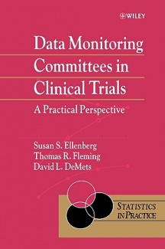
DMCs / DSMBs
Data Monitoring Committee / Data Safety Monitoring Board
Members
  1 DMC chair
  3-4 physicians/ clinitians
  1-2 statisticians

Slide 8
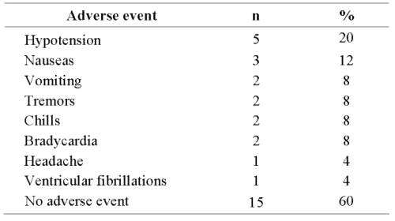
DMC Open Sessions
Sponsor allowed to participate
  Updates on enrollment and study status
  Explain interesting medical events
  Justify statistical methods chosen
Look at all enrolled patients

Slide 9
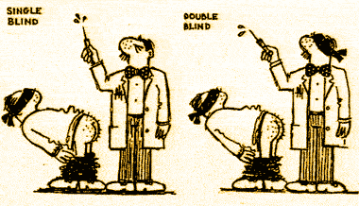
DMC Closed Sessions
Sponsor kicked out!
Information given per treatment arm
DMC members look for unusual events, differences between treatment arms
Must make a suggestion to the sponsor to continue/ discontinue the study
Notes:
Stop for: efficacy, lack of efficacy, futility

Slide 10
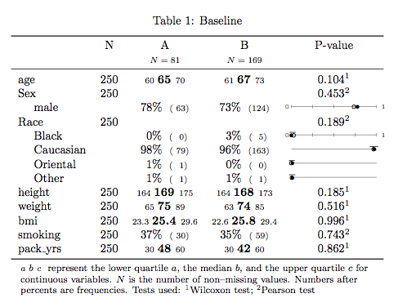
DMC Report – closed version

Slide 11
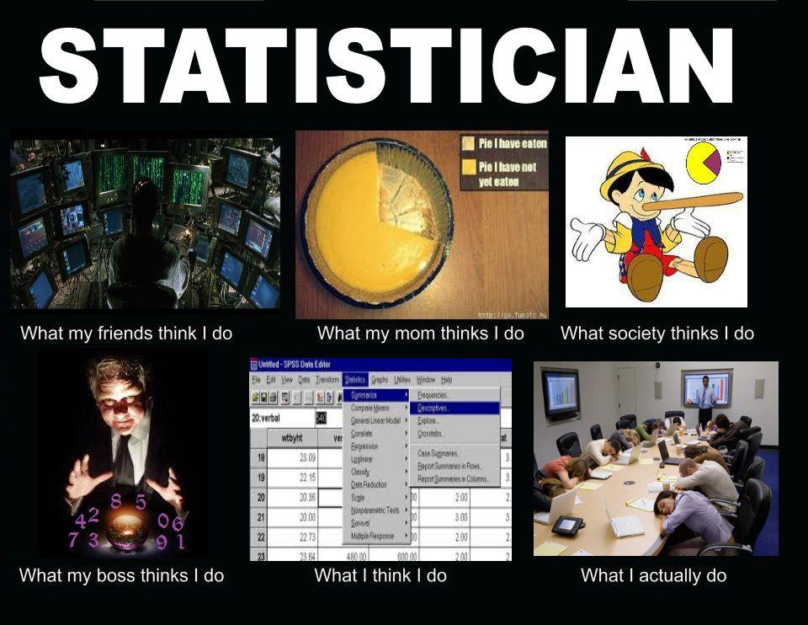
Job Opportunities

Slide 12

(Bio)statistician
Clinical
Non-Clinical
Study Management
Training programmers
Data enhancement
Emergency unblinding
Hosting DMCs
Modeling & Inference
Design
Research
Outside training
Simulations

Slide 13
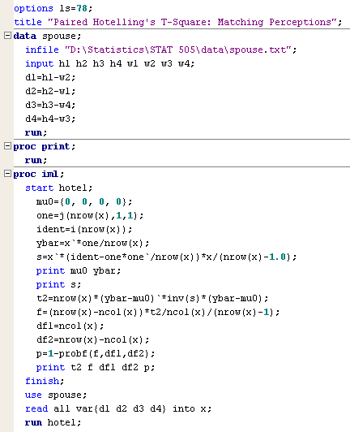
Statistical Programmer
Creating analysis datasets
Programming DMC report elements (TLFs)
Performing statistical tests
SAS ☹

Slide 14
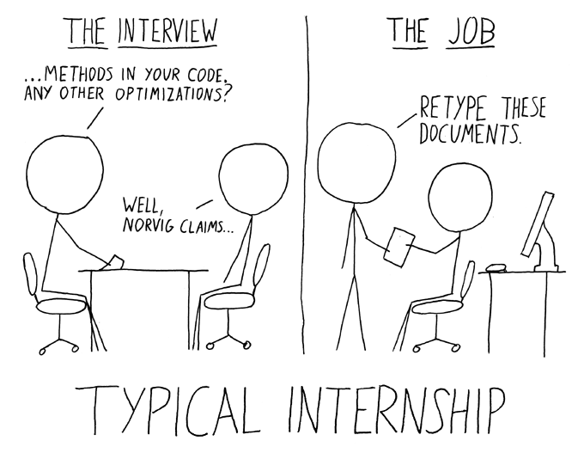
What did I do?

Slide 15

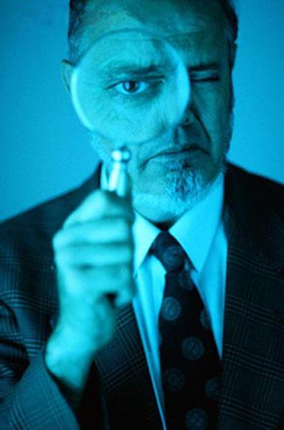
Tester
Quality control on DMC report elements
Check programmer’s results with independent code
Organize final reports
Buffer between statisticians and programmers

Slide 16
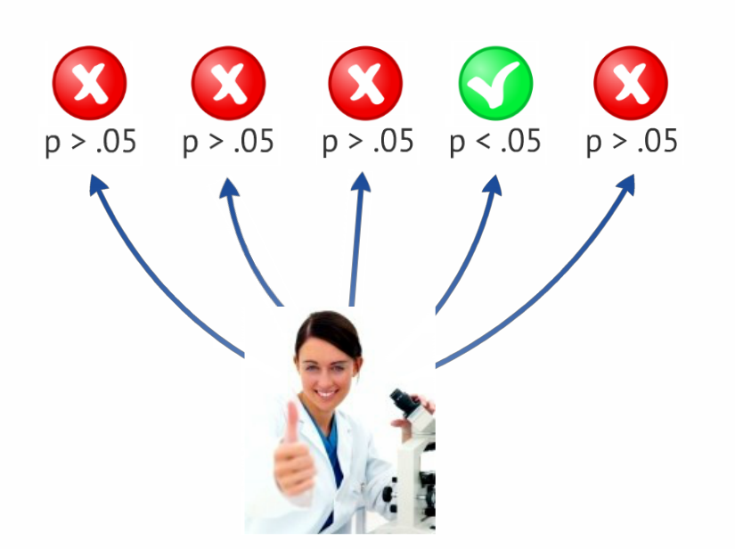
What the heck, FDA?!

Slide 17

FIN
Questions?

